Slide 1




Noida Institute of Engineering and Technology, Greater Noida
SENTIMENT MINING
Unit: I
Social Media Analytics
(ACSAI0622N)
Dr. Atul Pratap Singh (Asst. Professor)
AI Department
Course Details (B. Tech. 6th Sem)

Slide 2
Faculty Introduction
Name : Dr. Atul Pratap Singh
Qualification: B.Tech, M.Tech, Ph. D
Area of Specialization: Machine learning
Teaching experience: 16.6 years.

Slide 3
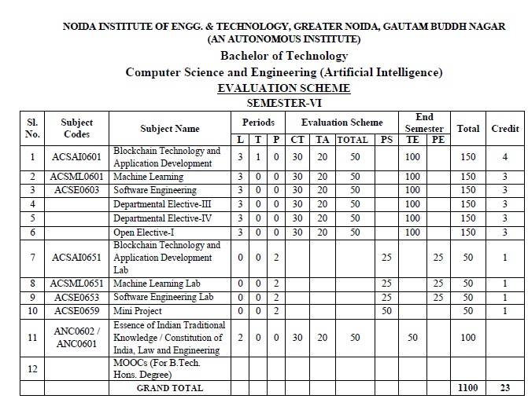
Evaluation Scheme
Python Web development with Django (Elective I)
Design Pattern (Elective II)

Slide 4
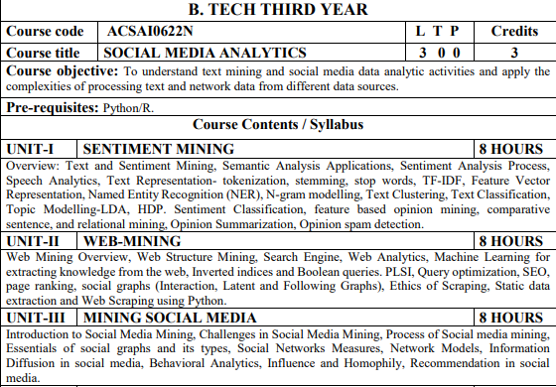
Syllabus

Slide 5
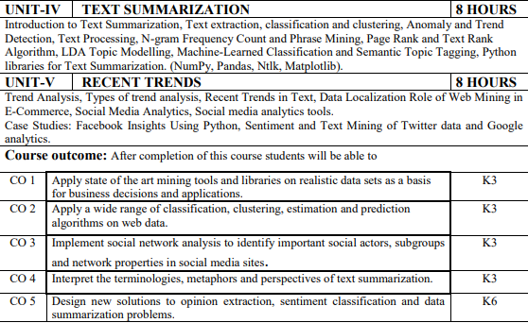
Syllabus

Slide 6
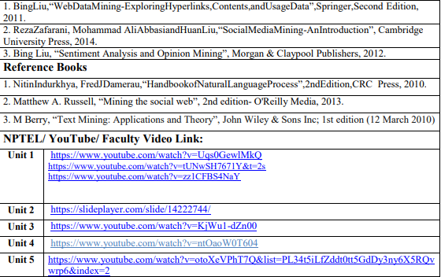
Syllabus

Slide 7
Branch Wise Application
1.Security
2. Digital Advertising
3. E-Commerce
4. Publishing
5. Massively Multiplayer Online Games
6. Backend Services and Messaging
7. Project Management & Collaboration
8. Real time Monitoring Services
9.Live Charting and Graphing
10. Group and Private Chat

Slide 8
Course Objective
In this semester, the students will
To understand text mining and social media data analytic activities and apply the
complexities of processing text and network data from different data sources.

Slide 9
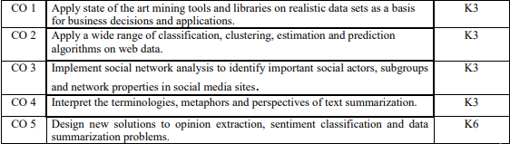
Course Outcomes (COs)
At the end of course, the student will be able to:

Slide 10
Program Outcomes (POs)
Engineering Graduates will be able to:
PO1 : Engineering Knowledge
PO2 : Problem Analysis
PO3 : Design/Development of solutions
PO4 : Conduct Investigations of complex problems
PO5 : Modern tool usage
PO6 : The engineer and society

Slide 11
Program Outcomes (POs)
Engineering Graduates will be able to:
PO7 : Environment and sustainability
PO8 : Ethics
PO9 : Individual and teamwork
PO10 : Communication
PO11 : Project management and finance
PO12 : Life-long learning

Slide 12

COs - POs Mapping
CO.K | PO1 | PO2 | PO3 | PO4 | PO5 | PO6 | PO7 | PO8 | PO9 | PO10 | PO11 | PO12
CO1 | 2 | 2 | 2 | 3 | 3 | - | - | - | - | - | - | -
CO2 | 3 | 2 | 3 | 2 | 3 | - | - | - | - | - | - | -
CO3 | 3 | 2 | 3 | 2 | 3 | - | - | - | - | - | - | -
CO4 | 3 | 2 | 3 | 2 | 3 | - | - | - | - | - | - | -
CO5 | 3 | 2 | 3 | 3 | 3 | - | - | - | - | - | - | -
AVG | 2.8 | 2.0 | 2.8 | 2.4 | 3.0 | - | - | - | - | - | - | -

Slide 13
Program Specific Outcomes(PSOs)
S. No. | Program Specific Outcomes (PSO) | PSO Description
1 | PSO1 | The ability to identify, analyze real world problems and design their ethical solutions using artificial intelligence, robotics, virtual/augmented reality, data analytics, block chain technology, and cloud computing.
2 | PSO2 | The ability to design and develop the hardware sensor devices and related interfacing software systems for solving complex engineering problems.
3 | PSO3 | The ability to understand inter-disciplinary computing techniques and to apply them in the design of advanced computing.
3 | PSO4 | The ability to conduct investigation of complex problems with the help of technical, managerial, leadership qualities, and modern engineering tools provided by industry-sponsored laboratories.

Slide 14
COs - PSOs Mapping
CO.K | PSO1 | PSO2 | PSO3 | PSO4
CO1 | 3 | - | - | -
CO2 | 3 | 2 | - | -
CO3 | 3 | 3 | - | -
CO4 | 3 | 3 | - | -
CO5 | 3 | 3 | - | -

Slide 15
Program Educational Objectives (PEOs)
Program Educational Objectives (PEOs) | PEOs Description
PEO-1 | Engage in successful professional practices in the area of Artificial Intelligence and pursue higher education and research.
PEO-2 | Demonstrate effective leadership and communicate as an individual and as a team in the workspace and society.
PEO-3 | Pursue life-long learning in developing AI-based innovative solutions for the betterment of society.

Slide 16
Result Analysis(Department Result & Subject Result & Individual result
Name of the faculty | Subject code | Result % of clear passed

Slide 17
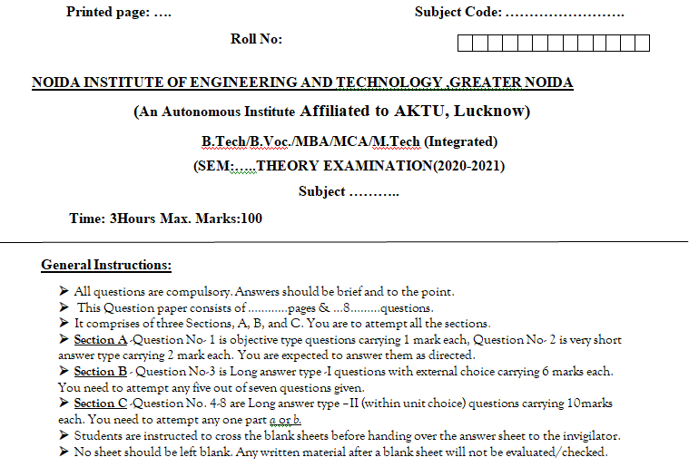
End Semester Question Paper Template

Slide 18
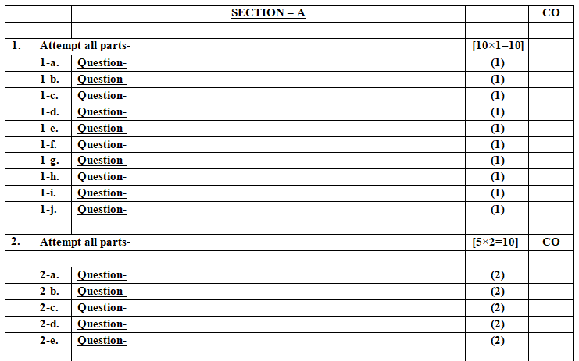
End Semester Question Paper Template

Slide 19
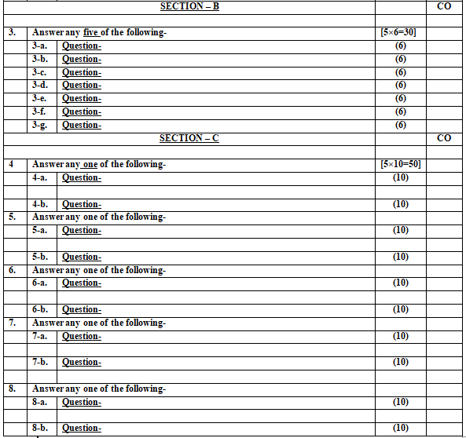
End Semester Question Paper Template

Slide 20
Prerequisite / Recap
Student should have knowledge of Knowledge of Data Analysis Tools and Web Technology.
Students should have good knowledge of Python Programming and Python coding experience.
knowledge of Computer and basic skill.
Good problem solving Skill .

Slide 21
Brief Introduction about the Subject with videos
YouTube /other Video Links
https://www.youtube.com/watch?v=Uqs0GewlMkQ
https://www.youtube.com/watch?v=tUNwSH7671Y&t=2s
https://slideplayer.com/slide/14222744/
https://www.youtube.com/watch?v=KjWu1
dZn00https://www.youtube.com/watch?v=ntOaoW0T604

Slide 22
Unit I Content
Overview: Text and Sentiment Mining
Semantic Analysis Applications
Sentiment Analysis Process
Speech Analytics
Text Representation- tokenization
stemming, stop words
TF-IDF, Feature Vector Representation
NER
N-gram modelling
Text Clustering
Text Classification
Topic Modelling-LDA

Slide 23
Unit I Content
Sentiment Classification
Opinion Summarization
Opinion spam.
Opinion spam detection.
Video Links
Daily Quiz
Weekly Assignment
MCQ
Expected Questions for University Exam
Recap of Unit
References

Slide 24
Unit I Objective
In Unit I, the students will be able to find:-
Text Representation- tokenization,stemming, stop words,Clustering as well.

Slide 25
Text mining and sentiment mining
Text mining and sentiment mining are techniques used in natural language processing (NLP) and data mining to extract valuable information and insights from textual data.
These techniques are particularly useful in analyzing large volumes of unstructured text data, such as social media posts, customer reviews, and news articles.

Slide 26
Text mining and sentiment mining
Text Mining:
Definition: Text mining, also known as text analytics, involves the process of extracting valuable information and patterns from unstructured text data.
Techniques:
Tokenization: Breaking down text into smaller units, such as words or phrases.
Stemming and Lemmatization: Reducing words to their root or base form to standardize variations.
Named Entity Recognition (NER): Identifying entities (e.g., names, locations, organizations) in the text.
Part-of-Speech Tagging: Assigning grammatical categories to words (e.g., noun, verb, adjective).
Text Clustering and Classification: Grouping similar documents or assigning predefined categories to texts.
Topic Modeling: Identifying topics or themes within a collection of documents.

Slide 27
Text mining and sentiment mining
Sentiment Mining:
Definition: Sentiment mining, or sentiment analysis, focuses specifically on determining the sentiment expressed in a piece of text, such as positive, negative, or neutral.
Techniques:
Rule-based Approaches: Defining rules and heuristics to classify sentiment based on predefined criteria.
Machine Learning Approaches: Training models, often using supervised learning, on labeled datasets to predict sentiment.
Lexicon-based Approaches: Using sentiment lexicons or dictionaries to assign sentiment scores to words and aggregating them to determine overall sentiment.
Deep Learning Approaches: Utilizing deep neural networks, such as recurrent neural networks (RNNs) or transformers, for more sophisticated sentiment analysis.

Slide 28
Text mining and sentiment mining
Applications:
Business Intelligence: Extracting insights from customer feedback, reviews, and social media to understand customer sentiments about products or services.
Social Media Monitoring: Analyzing social media content to gauge public opinion on specific topics or events.
Market Research: Identifying trends, preferences, and opinions in market-related textual data.
Customer Support: Automating the analysis of customer support tickets and feedback to improve service quality.
News Analysis: Assessing public sentiment toward news articles or events.

Slide 29
Text mining and sentiment mining
Challenges:
Ambiguity: Understanding context and handling ambiguous language.
Sarcasm and Irony: Detecting nuances like sarcasm and irony that may alter sentiment.
Domain-specific Language: Adapting models and lexicons to specific industries or domains.
Data Privacy: Ensuring compliance with privacy regulations when dealing with sensitive textual data.
Both text mining and sentiment mining play crucial roles in extracting meaningful insights from the vast amounts of textual data generated in today's digital age. They are integral components in various fields, including business, marketing, finance, and social sciences.

Slide 30
Topic Objective
To understand Semantic Analysis Applications .

Slide 31
Semantic Analysis Applications
Semantic analysis, also known as semantic processing, involves understanding the meaning of words, phrases, and overall language structure within a given context. This goes beyond the syntactic analysis of language (grammar and structure) to comprehend the intended meaning of words and their relationships. Here are several applications of semantic analysis across different domains:
Natural Language Understanding (NLU):
Chatbots and Virtual Assistants: Semantic analysis helps chatbots and virtual assistants understand user queries more accurately, enabling them to provide relevant and context-aware responses.

Slide 32
Semantic Analysis Applications
Search Engine Optimization (SEO):
Content Optimization: Semantic analysis is crucial for search engines to understand the context and relevance of content, improving search result accuracy and ranking.
Information Retrieval:
Document Classification: Semantic analysis aids in categorizing and organizing large sets of documents, making it easier to retrieve relevant information.
Text Summarization:
Automatic Summarization: Semantic analysis contributes to extracting the most important information from a piece of text, facilitating the creation of concise and coherent summaries.

Slide 33
Semantic Analysis Applications
Sentiment Analysis:
Fine-grained Sentiment Analysis: Semantic analysis enhances sentiment analysis by considering the nuances and context in which sentiments are expressed, leading to more accurate sentiment classification.
Question Answering Systems:
Understanding Context: Semantic analysis assists in understanding the context of questions, allowing question-answering systems to provide more accurate and relevant responses.
Knowledge Graphs:
Relationship Extraction: Semantic analysis is employed to identify and extract relationships between entities, contributing to the construction and enrichment of knowledge graphs.

Slide 34
Semantic Analysis Applications
E-commerce and Product Recommendations:
Product Matching: Semantic analysis aids in understanding product descriptions and user queries, improving the accuracy of product recommendations in e-commerce platforms.
Healthcare Informatics:
Clinical Text Analysis: Semantic analysis helps in extracting meaningful information from clinical notes and medical literature, contributing to healthcare research and decision-making.
Legal and Compliance:
Contract Analysis: Semantic analysis assists in understanding legal documents, identifying key clauses, and ensuring compliance with regulations.

Slide 35
Topic Objective
To understand Semantic Analysis Process .

Slide 36
Semantic Analysis Process
Sentiment analysis, also known as opinion mining, is the process of determining and extracting sentiments expressed in text data, such as reviews, social media posts, or customer feedback. The goal is to understand whether the expressed opinions are positive, negative, or neutral.
Data Collection:
Gather the textual data from relevant sources, such as social media platforms, customer reviews, surveys, or other text-rich datasets.
Data Preprocessing:
Clean the data by removing irrelevant information, special characters, and noise.
Tokenize the text into individual words or phrases.

Slide 37
Semantic Analysis Process
Handle issues like stemming or lemmatization to reduce words to their base forms.
Remove stop words (common words like "and," "the," etc.) that do not carry significant meaning for sentiment.
Feature Extraction:
Convert the preprocessed text into a format suitable for analysis, such as numerical vectors. Common methods include Bag-of-Words (BoW), TF-IDF (Term Frequency-Inverse Document Frequency), or word embeddings.

Slide 38
Semantic Analysis Process
Sentiment Labeling (Optional for Supervised Learning):
In supervised learning scenarios, where you have labeled training data, assign sentiment labels (e.g., positive, negative, neutral) to each piece of text in the training set.
Model Selection:
Choose a suitable sentiment analysis model based on the nature of the data and the available resources. Common models include:
Rule-based models: Define rules and heuristics to determine sentiment.

Slide 39
Semantic Analysis Process
Machine learning models: Train classifiers using algorithms like Support Vector Machines (SVM), Naive Bayes, or more advanced techniques like neural networks.
Pre-trained models: Use existing models like BERT, GPT, or others that have been trained on large datasets and fine-tuned for sentiment analysis.
Training (For Supervised Learning):
If using a supervised learning approach, split the data into training and testing sets. Train the selected model on the labeled training data.

Slide 40
Semantic Analysis Process
Model Evaluation:
Evaluate the performance of the model using the testing set. Common evaluation metrics include accuracy, precision, recall, and F1 score.
Prediction (For Unseen Data):
Use the trained model to predict sentiment for unseen or new data.
Post-processing:
Apply any necessary post-processing steps, such as adjusting confidence thresholds or handling ambiguous cases.

Slide 41
Semantic Analysis Process
Analysis and Interpretation:
Analyze the results to gain insights into the sentiments expressed in the text data.
Visualize the sentiment distribution or trends if necessary.
Feedback Loop (Optional):
If the analysis is part of an ongoing process, consider incorporating user feedback or continuously updating the model based on new data to improve accuracy over time.

Slide 42
Topic Objective
To understand Speech analytics .

Slide 43
Speech analytics
Speech analytics involves the use of technology to analyze spoken language in various forms, such as recorded calls, live conversations, or other audio sources. The goal is to extract valuable insights, patterns, and information from spoken words. Speech analytics is widely used in business and customer service, providing organizations with the means to understand customer interactions, improve service quality, and gain actionable intelligence.

Slide 44
Topic Objective
To understand tokenization .

Slide 45
Text Representation- tokenization
The first thing you need to do in any NLP project is text preprocessing. Preprocessing input text simply means putting the data into a predictable and analyzable form. It’s a crucial step for building an amazing NLP application.
There are different ways to preprocess text:
stop word removal
tokenization
stemming.

Slide 46
Text Representation- tokenization
Why do we need tokenization?
Tokenization is the first step in any NLP pipeline. It has an important effect on the rest of your pipeline. A tokenizer breaks unstructured data and natural language text into chunks of information that can be considered as discrete elements. The token occurrences in a document can be used directly as a vector representing that document.
This immediately turns an unstructured string (text document) into a numerical data structure suitable for machine learning. They can also be used directly by a computer to trigger useful actions and responses. Or they might be used in a machine learning pipeline as features that trigger more complex decisions or behavior.

Slide 47
Topic Objective
To understand Stemming .

Slide 48
Stemming
Stemming is a method of removing the suffix of the word and bringing it to a base word. Stemming is the normalization technique used in Natural language processing that reduces the number of computations required. We can do stemming in NLP using libraries such as PorterStemming, Snowball Stemmer, etc.
Errors in Stemming:
There are mainly two errors in stemming –
Over-stemming occurs when two words are stemmed from the same root that are of different stems. Over-stemming can also be regarded as false-positives.
Under-stemming occurs when two words are stemmed from the same root that are not of different stems. Under-stemming can be interpreted as false-negatives.

Slide 49
Stemming
Stemming is used in information retrieval systems like search engines.
It is used to determine domain vocabularies in domain analysis.
To display search results by indexing while documents are evolving into numbers and to map documents to common subjects by stemming.
Sentiment Analysis, which examines reviews and comments made by different users about anything, is frequently used for product analysis, such as for online retail stores. Before it is interpreted, stemming is accepted in the form of the text-preparation mean.
A method of group analysis used on textual materials is called document clustering (also known as text clustering)

Slide 50
Topic Objective
To understand Stop Words.

Slide 51
Stop Words
The words which are generally filtered out before processing a natural language are called stop words. These are actually the most common words in any language (like articles, prepositions, pronouns, conjunctions, etc) and does not add much information to the text. Examples of a few stop words in English are “the”, “a”, “an”, “so”, “what”.

Slide 52
Stop words
Stop words are available in abundance in any human language. By removing these words, we remove the low-level information from our text in order to give more focus to the important information. In order words, we can say that the removal of such words does not show any negative consequences on the model we train for our task.
Removal of stop words definitely reduces the dataset size and thus reduces the training time due to the fewer number of tokens involved in the training.

Slide 53
Topic Objective
To understand TF-IDF .

Slide 54
TF-IDF
TF-IDF stands for term frequency-inverse document frequency and it is a measure, used in the fields of information retrieval (IR) and machine learning, that can quantify the importance or relevance of string representations (words, phrases, lemmas, etc) in a document amongst a collection of documents.
Term Frequency - Inverse Document Frequency (TF-IDF) is a widely used statistical method in natural language processing and information retrieval. It measures how important a term is within a document relative to a collection of documents (i.e., relative to a corpus).

Slide 55
Topic Objective
To understand NER .

Slide 56
NER
Named Entity Recognition (NER) refers to methods and processes of identifying entities in text and applying labels to them that can be used for further analysis or processing.
NER is used for information extraction that searches and segmentizes named entities in text. Named entities are defined as proper nouns that refer to specific individuals, places, organizations, or things. NER is a challenging task because named entities can vary in length and can appear in different forms. For example, the named entity “New Orleans” can appear as “New Orleans,” etc.

Slide 57
How NER Works?
A named entity is a real-world object such as a person, place, or organization, that can be denoted with a proper name. NER is used in a variety of applications, including information extraction, question answering, and machine translation.
An important part of NER is the recognition of common syntactic patterns. NER systems also use natural language processing techniques, such as word embedding and machine learning, to improve the accuracy of the recognition process.
There are a number of different algorithms that can be used for Named Entity Recognition. There are different algorithms that can be used for this.
Two of the most common ones are:
Maximum Entropy Markov Model (MEMM), and
Common Random Fields (CRF).

Slide 58
Topic Objective
To understand N-gram modelling .

Slide 59
N-gram modelling
An n-gram is a collection of n successive items in a text document that may include words, numbers, symbols, and punctuation. N-gram models are useful in many text analytics applications where sequences of words are relevant, such as in sentiment analysis, text classification, and text generation.
n-gram models are widely used in statistical natural language processing. In speech recognition, phonemes and sequences of phonemes are modeled using a n-gram distribution. For parsing, words are modeled such that each n-gram is composed of n words.
Sentiment analysis of free-text documents is a common task in the field of text mining. In sentiment analysis predefined sentiment labels, such as "positive" or "negative" are assigned to text documents.

Slide 60
N-gram modelling
N-Gram models work by taking a sequence of items, and predicting upcoming items. For example, imagine a string of letters used for DNA sequencing (i.e. GATC). An N-Gram model will analyze the sequence of letters and, utilizing training data, creates a probability distribution for the likelihood of upcoming values.

Slide 61
Topic Objective
To understand Text Classification .

Slide 62
Text Classification
Text Classification and sentiment analysis is a very common machine learning problem and is used in a lot of activities like product predictions, movie recommendations, and several others. Currently, for every machine learner new to this field, like myself, exploring this domain has become very important. After exploring the topic, I felt, if I share my experience through an article, it may help some people trying to explore this field. So, I will try to build the whole thing from a basic level, so this article may look a little long, but it has some parts you can skip if you want.

Slide 63
Text Classification (Conti……)
Text classification problems like sentimental analysis can be achieved in a number of ways using a number of algorithms. These are majorly divided into two main categories:
A bag of Word model: In this case, all the sentences in our dataset are tokenized to form a bag of words that denotes our vocabulary. Now each individual sentence or sample in our dataset is represented by that bag of words vector. This vector is called the feature vector. For example, ‘It is a sunny day’, and ‘The Sun rises in east’ are two sentences. The bag of words would be all the words in both the sentences uniquely.
The second method is based on a time series approach: Here each word is represented by an Individual vector. So, a sentence is represented as a vector of vectors.

Slide 64
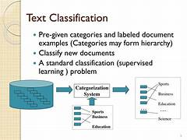
Text Classification (Conti……)
.

Slide 65
Topic Objective
To understand Text clustering .

Slide 66
Text clustering
Text clustering is the task of grouping a set of unlabelled texts in such a way that texts in the same cluster are more similar to each other than to those in other clusters. Text clustering algorithms process text and determine if natural clusters (groups) exist in the data.
Google's search engine is probably the best and most widely known example. When you search for a term on Google, it pulls up pages that apply to that term, but have you ever wondered how Google can analyze billions of web pages to deliver an accurate and fast result? It's because of text clustering!

Slide 67
Topic Objective
To understand Topic Modelling-LDA .

Slide 68
Topic Modelling-LDA
Topic modeling is a process to automatically detect topics present in the text and derive hidden patterns in the corpus and thus assist in better decision making. Topics can also be defined as a repeated pattern of most occurring terms in a corpus of text.
For example, there are 1000 documents and 500 words in each document. So to process this it requires 500*1000 = 500000 threads. So when you divide the document containing certain topics then if there are 5 topics present in it, the processing is just 5*500 words = 2500 threads.

Slide 69
Topic Modelling-LDA(continue…)
Sentiments, feelings and emotions are an integral part of human nature. Over 2.5 quintillion bytes of data are created every single day. Twitter itself generates 500 million tweets every day. Sentiment Analysis deals with examining the study of textual data like posts, blogs, reviews, etc. expressed by users regarding their views and opinions about a specific product, service, event, idea, news or person.
The most common use of Sentiment Analysis is classifying the text into class(es). It can either be binary like positive/negative, yes/no, etc or multi-class like positive-negative-neutral, yes-no-maybe, etc. Sentiment Analysis aids organisations to track the following:
· Brand popularity and acceptance
· New product anticipation and perception
· Company reputation
· Understand the customer experience

Slide 70
Topic Objective
To understand Sentiment classification .

Slide 71
Sentiment Classification
Sentiment classification is the automated process of identifying opinions in text and labeling them as positive, negative, or neutral, based on the emotions customers express within them.
We are living in a digital world today. From the beginning of the day till we say ‘Good Night’ to our loved ones we consume loads of data either in form of visuals, music/audio, web, text, and many more sources.
Today we will explore one of these sources of data and see if we can gain information out of it. We will use ‘Text’ data which is available in abundance thanks to reviews, feedback, articles, and many other data collection/publishing ways.

Slide 72
Sentiment Classification(Conti…)
Sentiment Classification
The dataset that we just discussed contains movie reviews. Each review is either labelled as positive or negative. The dataset contains the ‘text’ and ‘sentiment’ fields. These fields are separated by the ‘tab’ character. See below for details:
1. text:- Sentence that describes the review.
2. sentiment:- 1 or 0. 1 represents positive review and 0 represents negative review.
Now we will discuss the complete process of ‘sentiment classification’. Below will be the flow of the project.
Loading The dataset
Exploring Dataset
Text Pre-Processing
Build a model for sentiment classification
Split dataset
Make the prediction on test case
Finding model Accuracy
Loading the Dataset
Loading the data using panda’s read_csv() method is done as follows:

Slide 73
Topic Objective
To understand Opinion Summarization .

Slide 74
Opinion Summarization
Opinion summarization is the process of condensing and presenting the key opinions, sentiments, or viewpoints expressed in a set of documents or a collection of text. This task is particularly useful for dealing with large volumes of opinions, such as customer reviews, online discussions, or social media comments .

Slide 75
Opinion Summarization
Data Collection:
Gather the relevant textual data containing opinions. This could include product reviews, forum discussions, social media comments, or any other source where opinions are expressed.
Text Preprocessing:
Clean the text data by removing irrelevant information, special characters, and noise.
Tokenize the text into sentences or phrases.
Apply stemming or lemmatization to reduce words to their base forms.
Remove stop words to focus on meaningful content.

Slide 76
Opinion Summarization
Opinion Extraction:
Identify and extract opinions from the text. This involves recognizing subjective expressions, sentiment-bearing phrases, and expressions of opinions.
Sentiment Analysis:
Conduct sentiment analysis on the extracted opinions to determine whether each opinion is positive, negative, or neutral. This step helps in understanding the overall sentiment of the opinions.

Slide 77
Opinion Summarization
Summarization Techniques:
Apply text summarization techniques to generate concise summaries of the opinions. Common approaches include:
Extractive Summarization: Selecting and extracting key sentences or phrases from the original text based on importance or relevance.
Abstractive Summarization: Generating new sentences that capture the essential meaning of the opinions in a more condensed form.

Slide 78
Opinion Summarization
Ranking and Prioritization:
If there are a large number of opinions, rank them based on factors such as sentiment strength, relevance, or user engagement to prioritize the most impactful opinions.
Summarization Output:
Present the summarized opinions in a coherent and easily understandable format. This could be in the form of bullet points, key highlights, or a concise paragraph.

Slide 79
Topic Objective
To understand Opinion spam detection. .

Slide 80
Opinion spam detection.
Opinion spam detection is the process of identifying and filtering out fake, deceptive, or fraudulent opinions and reviews from genuine ones. With the proliferation of online reviews and opinions on platforms such as e-commerce websites, social media, and review sites, detecting spam opinions is crucial for maintaining the credibility of user-generated content.

Slide 81
Video Links
https://www.youtube.com/watch?v=Uqs0GewlMkQ
https://www.youtube.com/watch?v=tUNwSH7671Y&t=2s
https://slideplayer.com/slide/14222744/

Slide 82
Daily Quiz
1.The subfield of data science/machine learning related to text is called
Image processing
Regression
Classification
Natural language processing
2.Which is the most useful metric from VADER for sentiment analysis?
Negative
Positivity
Intensity
Compound
3.The Bag-of-Words approach_________
keeps word order, keeps word multiplicity
keeps word order, disregards word multiplicity
disregards word order, disregards word multiplicity
disregards word order, keeps word multiplicity

Slide 83
Daily Quiz
4.Which company’s tone analyzer service did we discuss?
Google
Apple
Amazon
IBM
5. Which news sources did we use?
Reuters
News API
All of above
None of above

Slide 84
Glossary Questions
Machine Translation is that convert_____________
____________charts are used in visualizations of results?
_____________python libraries used in NLP?
_______________is the name for the space inside which a robot unit operates?
_______________ step is the process of breaking down documents into smaller units of analysis?

Slide 85
MCQ
1.What is the primary purpose of social media analytics?
A) Increase follower count
B) Measure and analyze social media data
C) Create engaging content
D) Post regularly
Answer: B) Measure and analyze social media data
Question 2.: Which of the following metrics is commonly used to assess social media engagement?
A) Email open rate
B) Website traffic
C) Likes, shares, and comments
D) Customer satisfaction score (CSAT)
Answer: C) Likes, shares, and comments

Slide 86
MCQ
Question: What is sentiment analysis in the context of social media analytics?
A) Analyzing the tone of social media content
B) Counting the number of followers
C) Measuring the length of social media posts
D) Tracking the frequency of hashtag usage
Answer: A) Analyzing the tone of social media content
Question: Which of the following tools is commonly used for social media analytics?
A) Photoshop
B) Microsoft Word
C) Google Analytics
D) Microsoft Excel
Answer: C) Google Analytics

Slide 87
MCQ
Question: What is the purpose of a social media analytics report?
A) Increase advertising budget
B) Share insights and performance metrics
C) Schedule social media posts
D) Design marketing campaigns
Answer: B) Share insights and performance metrics
Question: What is the training process in text classification models?
A) Providing the model with labeled data to learn patterns
B) Formatting the text for better readability
C) Assigning random categories to text samples
D) Removing all punctuation from the text
Answer: A) Providing the model with labeled data to learn patterns

Slide 88
MCQ
Question: What is text classification primarily used for?
A) Sorting images
B) Analyzing numerical data
C) Categorizing text into predefined categories
D) Formatting documents
Answer: C) Categorizing text into predefined categories
Question: Which machine learning technique is commonly used for text classification?
A) Regression analysis
B) Clustering
C) Natural Language Processing (NLP)
D) Decision trees
Answer: C) Natural Language Processing (NLP)

Slide 89
MCQ
Question: In the context of text classification, what is a "feature" typically referring to?
A) The font style used in the text
B) A characteristic or attribute of the text
C) The length of the document
D) The language of the text
Answer: B) A characteristic or attribute of the text

Slide 90
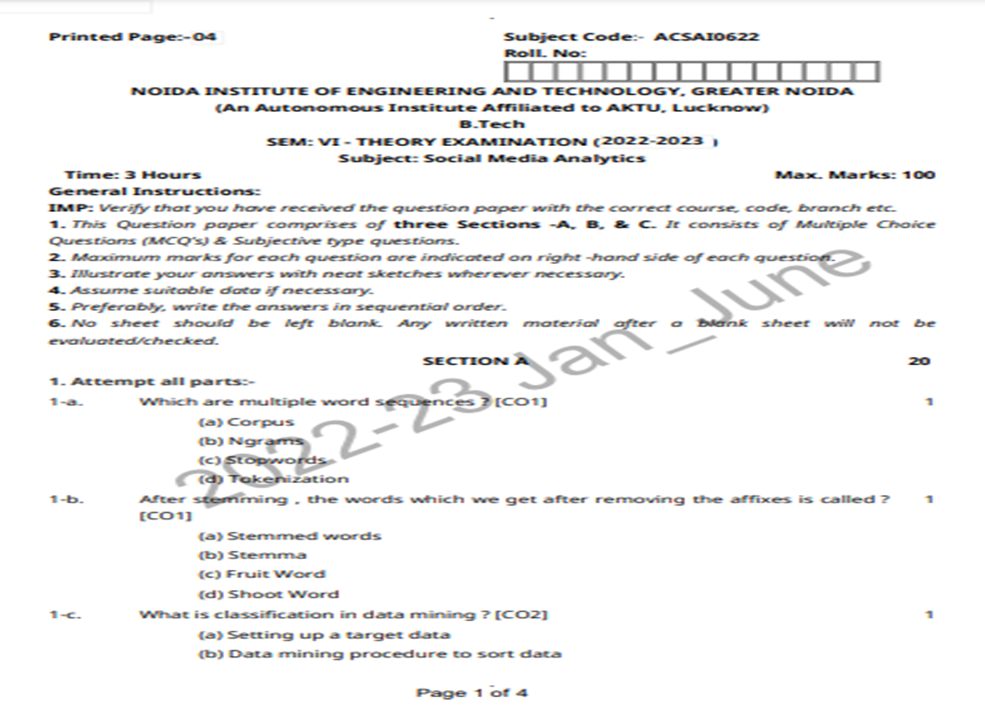
Old Question Paper

Slide 91
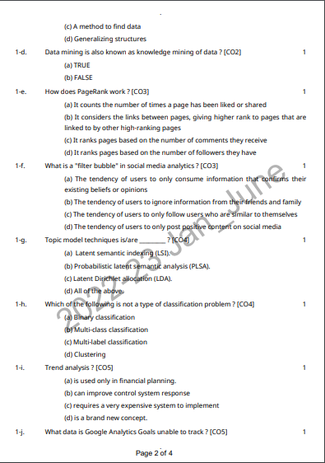
Old Question Paper

Slide 92
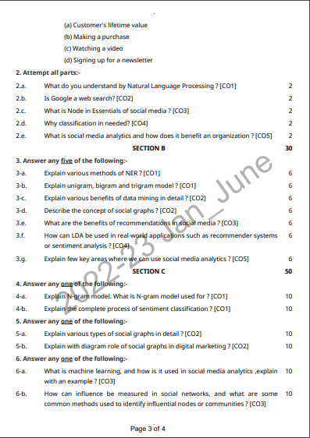
Old Question Paper

Slide 93
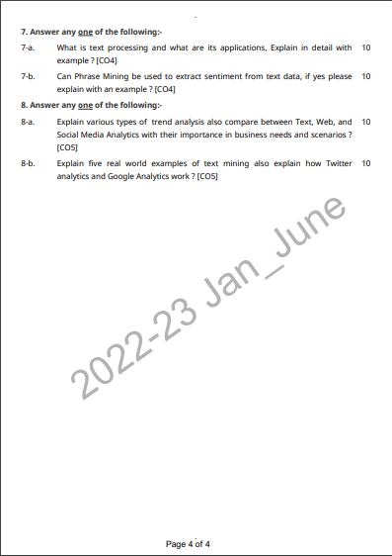
Old Question Paper

Slide 94
Weekly Assignment
What is Text Representation?
Explain Stemming with Example.
What is Topic Modelling?Explain Topic Modelling with LDA.
What is Feature based opinion Mining?
Explain N-gram Modelling.
Explain Comparative sentence.

Slide 95
Expected Questions for University Exam
Explain various types of trend analysis also compare between Text, Web, and
Social Media Analytics with their importance in business needs and scenarios ?
Explain five real world examples of text mining also explain how Twitter
analytics and Google Analytics work ?
Explain various methods of NER ?
Explain unigram, bigram and trigram model ?
Explain various benefits of data mining in detail ?
Describe the concept of social graphs ?
What are the benefits of recommendations in social media ?

Slide 96
Recap of Unit
We have learnt in this unit about :
Text and Sentiment Mining, Semantic Analysis Applications, Sentiment Analysis Process,
Text Representation- tokenization, stemming, stop words, TF-IDF, Feature Vector
Representation, Named Entity Recognition (NER), N-gram modelling, Text Clustering, Text Classification,
Topic Modelling-LDA, HDP.
Opinion Summarization, Opinion spam detection

Slide 97

References:-
https://www.youtube.com/watch?v=KjWu1
dZn00https://www.youtube.com/watch?v=ntOaoW0T604

